Slide 1
Resume Writing Tips
Judy Liu

Slide 2
Importance of Resumes
First impression
Recruiters are busy!
Formatting. Formatting. Formatting
Notes:
Especially for cold applications (though highly recommend find referral), resume is first impression (foot in the door). Recruiters go through hundreds of resumes – you need something clean, eye catching, and something that represents you (gets the key across)

Slide 3
Tips
FONT: Use a clear, professional font (don’t use Comic Sans or try to be creative – it’s most important for your resume to be readable)
FORMATTING: Sectionalize your resume
Name your file properly (e.g., First and last name)
PDF your resume
Reverse-chronological order
3-5 bullets per position/role
Quantify your experience (use numbers!)
Use action verbs (e.g., developed, spearheaded, organized, executed, etc.)
Make sure your verb tenses are correct

Slide 4
Logistics and Demo
How to PDF
How to edit file name

Slide 5
Examples
Experienced Investment Banker who has worked on a number of M&A deals. Collaborated with C-Suite members. Coaching experience.
An Investment Banking Associate with 10+ years of experience. Worked on and closed 20+ sell- and buy-side M&A deals each worth about $1B on average. Collaborated with CEOs and CFOs at 10+ venture-funded startups and IPO/M&A candidates. Served as a recruiter, and mentored over 10 new Analysts and Associates.

Slide 6
Example Bullets
Assisted and supported a deal team on a successful $3.5B acquisition of a public company by a large private equity firm.
Interacted with high-profile clients and various levels of management, as an integral part of engagement teams on 10+ full cycles of transactional execution.
Assisted in the preparation of over 50 PowerPoint decks based on client materials.

Slide 7
Example Bullets Cont.
Managed the company’s Twitter, Instagram, Facebook, and LinkedIn profiles with a combined following of 50,000+.
Planned website development and SEO strategy in accordance with Google Analytics data, driving a y/y increase in web traffic by 27%.

Slide 8
How to Incorporate your Japanese Experience
Have a “Skills” section or “Language” section
Describe your fluency skills briefly
Do you have a certification? JLPT? List it
What did you do in Japanese Club? Did you organize an event? Manage the budget or finances? Connect people? How many members are in the club?
What did you do in Japan? How were you involved in cultural exchange? Events?
Did you volunteer for an event? Have an “Activities” section

Slide 9
Example Section
EDUCATION
2008–2012 Clarkson University, BA in Liberal Arts
Pursued a passion for Spanish and Farsi.
Vice President, Student International Club.

Slide 10
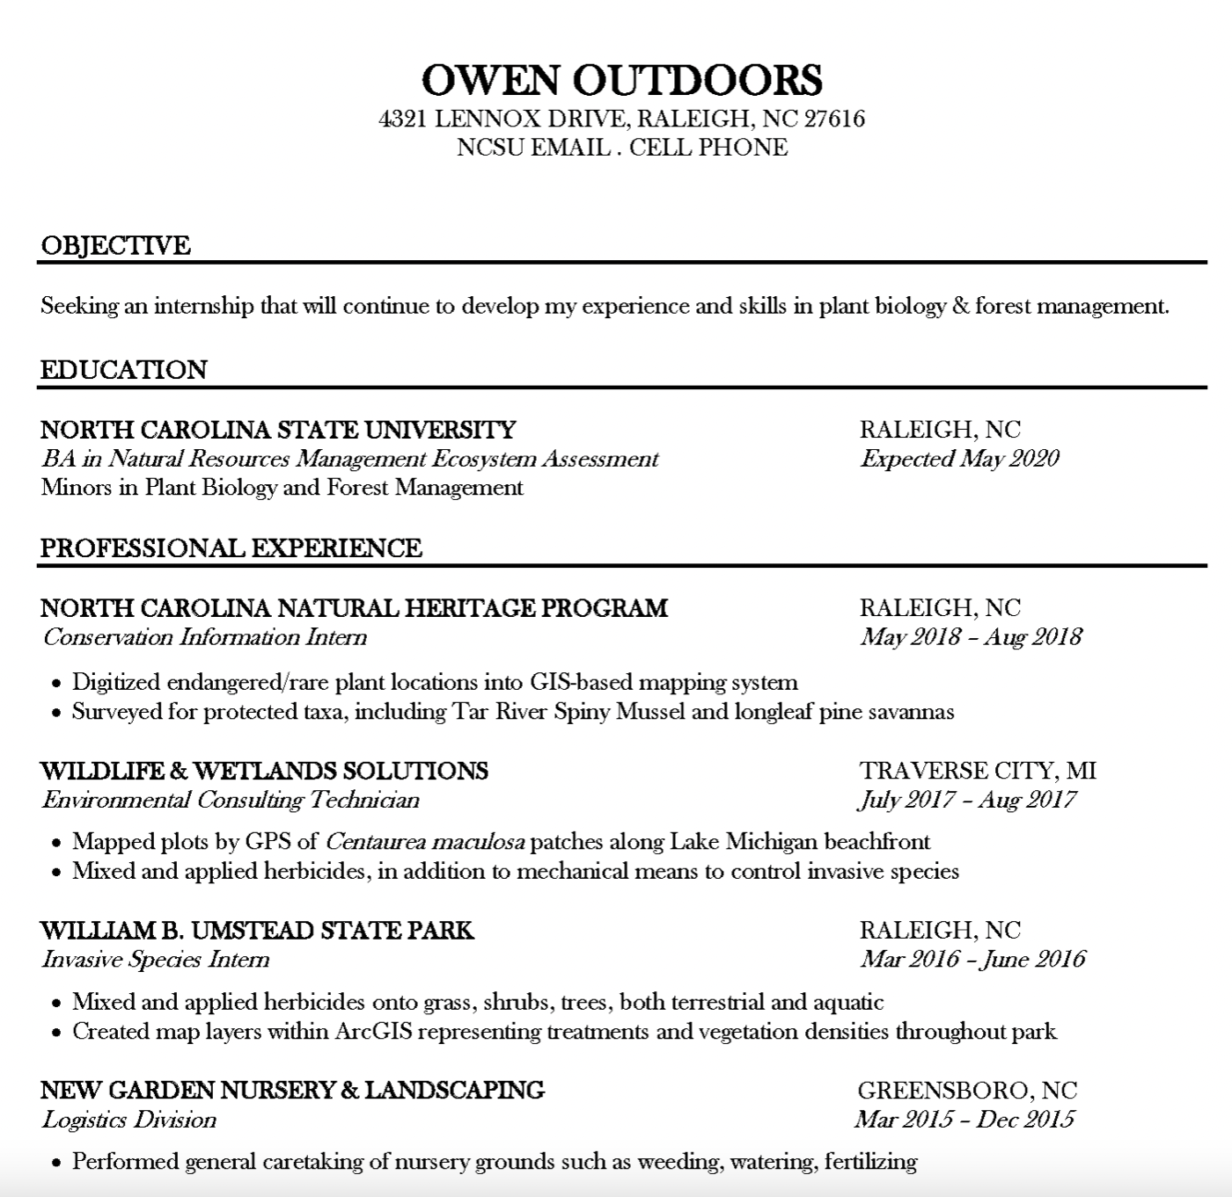
*From NC State University
Notes:
https://careers.dasa.ncsu.edu/resumes/

Slide 11
Resources
Resume verbs to use
Example resume formats

Slide 12
Q&A

